Slide 1


MLSA INTERNSHIP KIET
This presentation explores the creation of a personal webpage and a simple calculator. Learn HTML, CSS, and JavaScript to bring your ideas to life. We'll cover the basics of web development to help you build your own projects.
Notes:
1

Slide 2
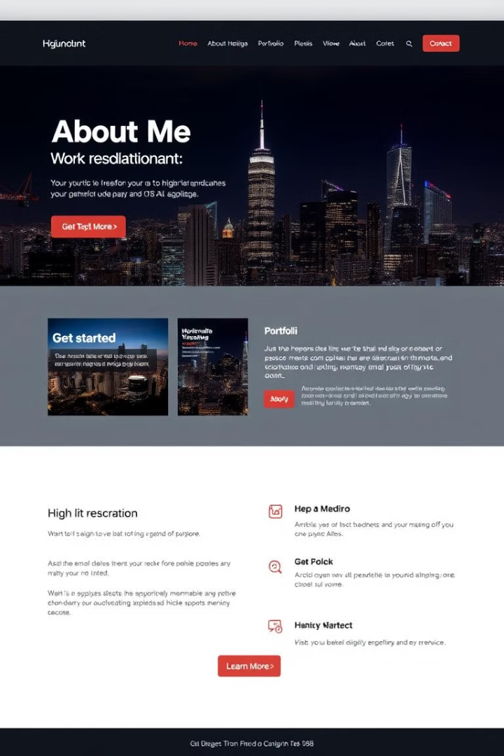
Creating a Personal Webpage
1
Showcase Yourself
2
Build Your Online Presence
Use your webpage to share your skills, interests, and experiences with the world.
A personal webpage allows you to create a professional online identity and connect with others.
3
Share Your Work
4
Easy to Maintain
Showcase projects, designs, or writings to potential employers or collaborators.
Simple tools and languages make updates and changes a breeze.
Notes:
2

Slide 3
How to Create Using HTML
HTML Basics
Elements and Tags
Structure and Content
HTML (HyperText Markup Language) is the foundation of webpages. It defines the structure and content of your website.
HTML uses tags to define different elements like headings, paragraphs, images, and links.
Organize your content using headings, lists, paragraphs, and other HTML elements.
Notes:
3

Slide 4
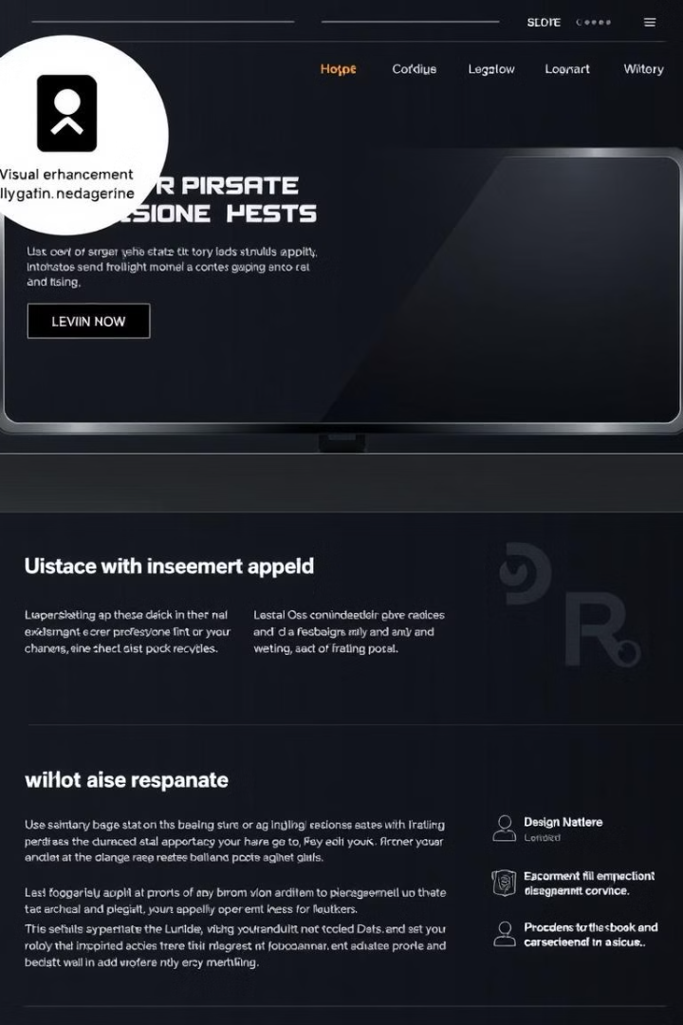



How to Create Using CSS
CSS Basics
Cascading Style Sheets (CSS) control the visual presentation of your webpage, including colors, fonts, layouts, and animations.
Styling Elements
CSS allows you to apply styles to individual HTML elements or groups of elements.
Creating Layouts
Use CSS to create responsive layouts that adapt to different screen sizes.
Notes:
4

Slide 5
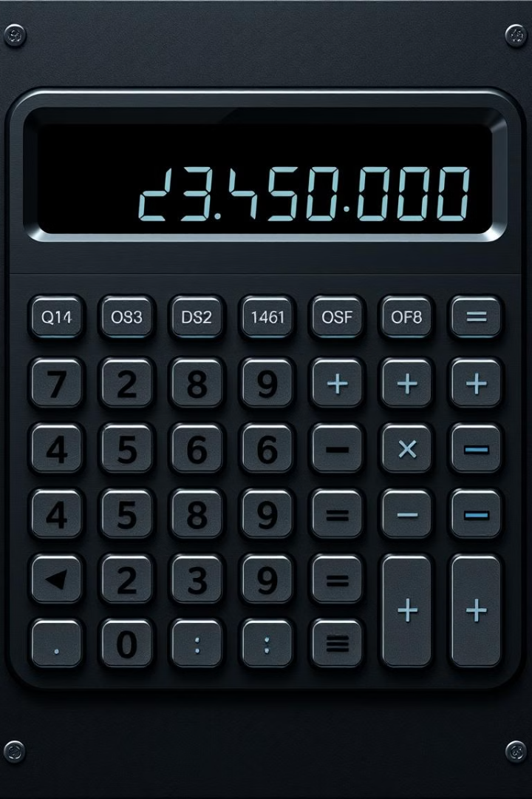
Creating a Simple Calculator
User Interface
User Input
Design a visually appealing interface with buttons for numbers, operators, and a display to show results.
Capture user input from the buttons and store it for calculations.
Calculations
Perform mathematical calculations based on the user's input and display the results.
Notes:
5

Slide 6
How Created Using HTML
Structure
Elements and Attributes
Layout
Use HTML to create the basic structure of the calculator, including the buttons, display, and input fields.
Utilize appropriate HTML elements and attributes to represent the calculator's components.
Organize the calculator's elements within the HTML structure to achieve a clean and functional layout.
Notes:
6

Slide 7
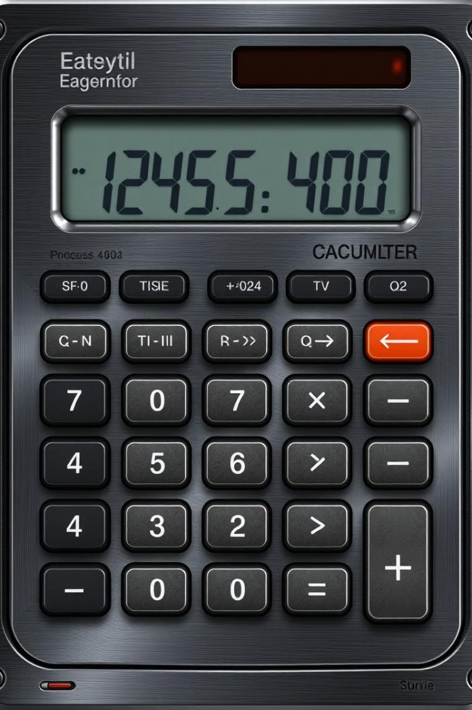
How Created Using CSS
Styling Buttons
1
Customize the appearance of the calculator buttons using CSS for colors, fonts, sizes, and hover effects.
Designing the Display
2
Style the calculator's display to make it readable and visually appealing.
Creating a Responsive Layout
3
Ensure the calculator adapts well to different screen sizes using CSS media queries.
Notes:
7

Slide 8
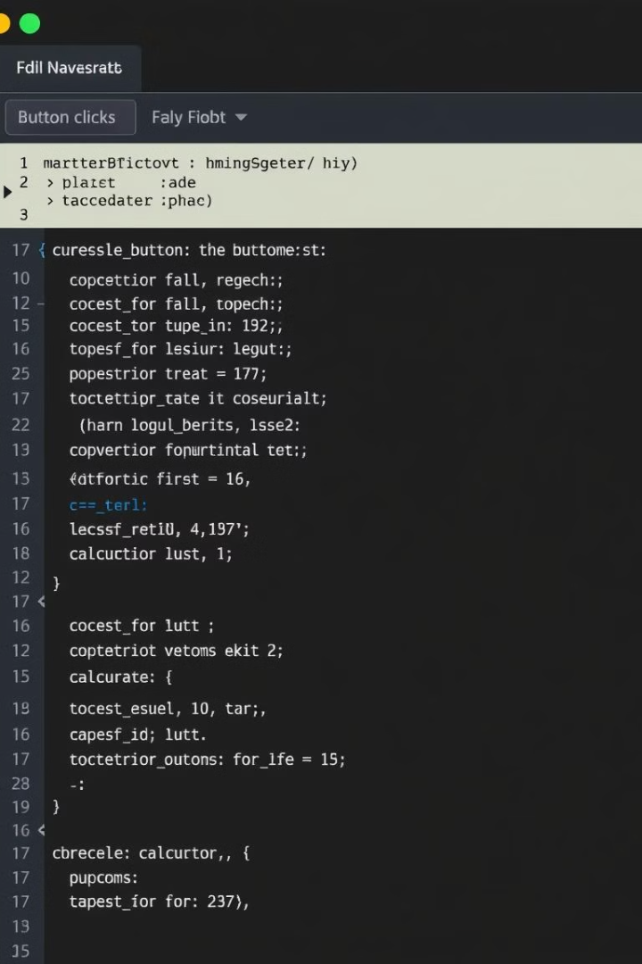



How Created Using JavaScript
Event Handling
Use JavaScript to handle user interactions with the calculator buttons.
Performing Calculations
Implement JavaScript functions to perform mathematical calculations based on user input.
Updating the Display
Use JavaScript to update the calculator's display with the results of calculations.
Notes:
8

Slide 9
ABHIJEET VINAY JHA
CSE
2300290100007
2nd Year
Notes:
9

Slide 10

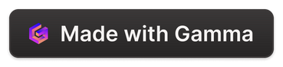
THANK YOU
Notes:
10

